Slide 1
Getting Started with XAML
Silverlight, WPF, and Windows 8

Slide 2
What we’ll probably cover
XAML basics
The property system
Layout
Input
Binding
Threading concerns
Anything you ask about and we have time to dive into

Slide 3
Who this is for
Developers completely new to XAML (WPF/Silverlight/Win8)
Experienced XAML devs can stay for entertainment value, but there’s not much new for them
People just trying to avoid going to HTML sessions
Your time is valuable

Slide 4
Why learn XAML?
Reusable skill
Applies to Windows Phone, WPF, Silverlight, Windows 8 (C#, VB and C++) and even .NET Micro Framework
It helps make app dev easier
It’s interesting
It has a future in Windows 8 too

Slide 5
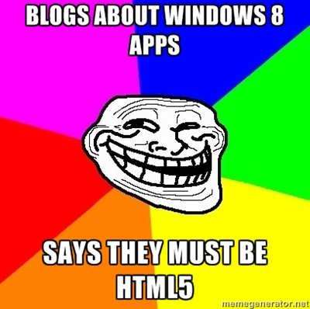
XAML is important in Windows 8
HTML/JS/CSS, XAML C#/VB, XAML C++ all on equal footing

Slide 7
What we won’t cover
Demos of Windows 8 itself
We’re a couple weeks too early for that
I’ll talk to commonalities and differences
HTML, CSS, JavaScript and other things that give me a headache

Slide 8
Where to find help
Our Community Sites
silverlight.net
windowsclient.net
asp.net
dev.windows.com
MSDN: msdn.microsoft.com
My Blog: 10rem.net
Will include any updated source/examples
Twitter: @pete_brown
Mail pete.brown@microsoft.com

Slide 9
End of deck (and memes)

